Slide 1
Decentralized Finance (DeFi)

Slide 2
Decentralized finance
Financial services deployed via smart contracts
Smart contracts: computer programs with deterministic execution
Censorship-resistant provided by consensus
Transparent
Composable

Slide 4
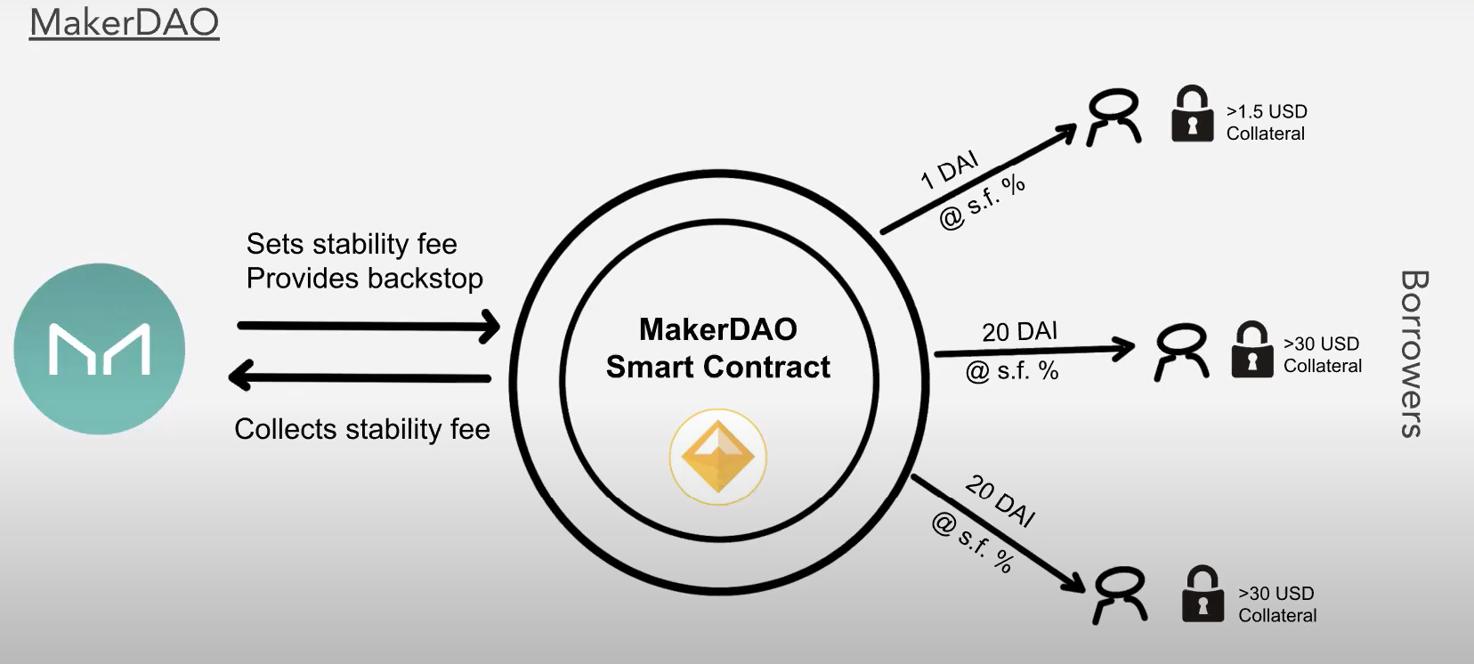

Slide 5
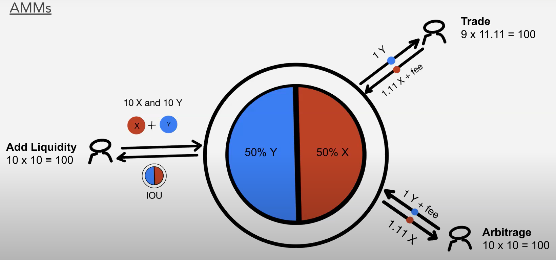

Slide 7
Stablecoins
Tether
MakerDAO
USDC
…

Slide 8
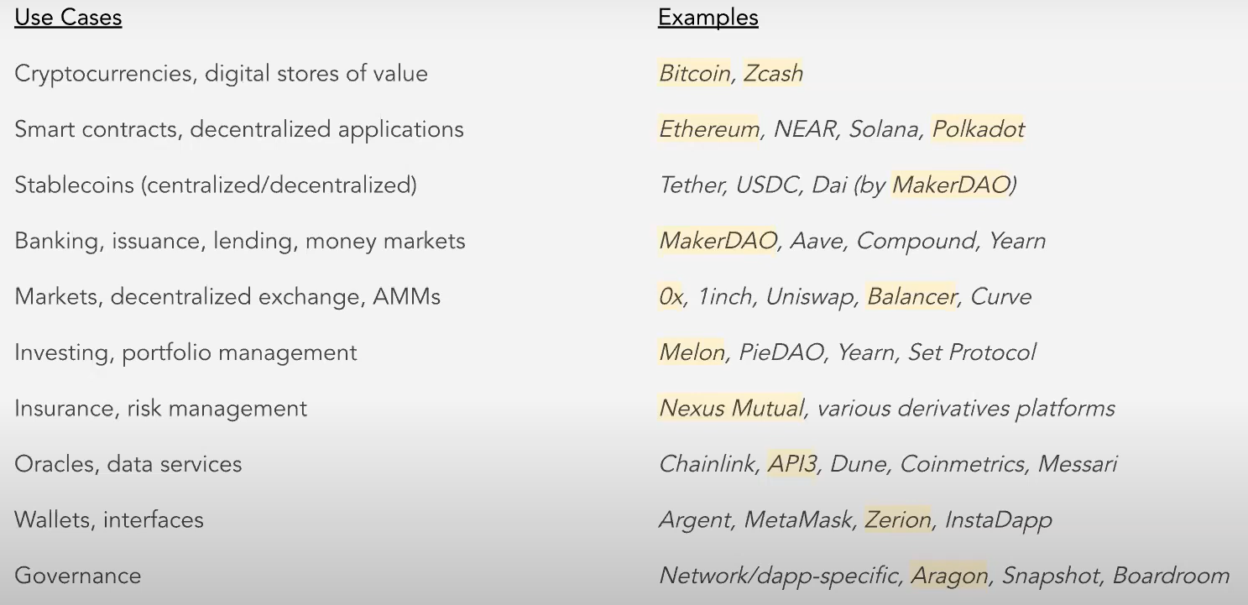
Source: Placeholder

Slide 9
Growth of DeFi
Still a new market
Key metrics
Market cap: https://www.coingecko.com/en/defi
Transaction/trading volume: https://duneanalytics.com/queries/1847
Total value locked (TVL): https://defipulse.com/
Users: https://duneanalytics.com/rchen8/defi-users-over-time

Slide 10
Some future challenges
Blockchain scaling
Privacy
Chain interoperability
Oracles
Capital efficiency
Manipulations (e.g. MEV)

Slide 11
Defi attacks
https://cryptosec.info/defi-hacks/

Slide 12
Some history of Stablecoins

Slide 13
Gen I: Tether (USDT)
Backed by USD one-to-one (originally claimed; later modified)
Created in 2014 (Tether Holdings Limited) in the British Virgin Islands
Key: full collateral by safe assets (at least claimed)
Intermittent minting (signs of breaking promise? Expected ratchet effect?)

Slide 14
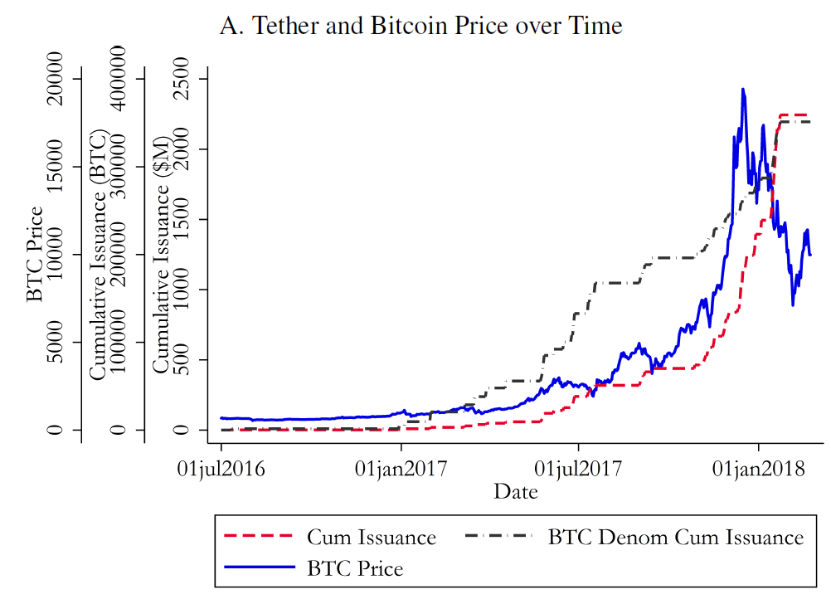
Source: Griffin, John M., and Amin Shams. "Is Bitcoin really untethered?." The Journal of Finance 75, no. 4 (2020): 1913-1964.

Slide 15
Gen I: Tether (USDT)
Backed by USD one-to-one (originally claimed; later modified)
Created in 2014 (Tether Holdings Limited) in the British Virgin Islands
Key: full collateral by safe assets (at least claimed)
Intermittent minting (signs of breaking promise? Expected ratchet effect?)
Difficult (and costly) to redeem

Slide 16
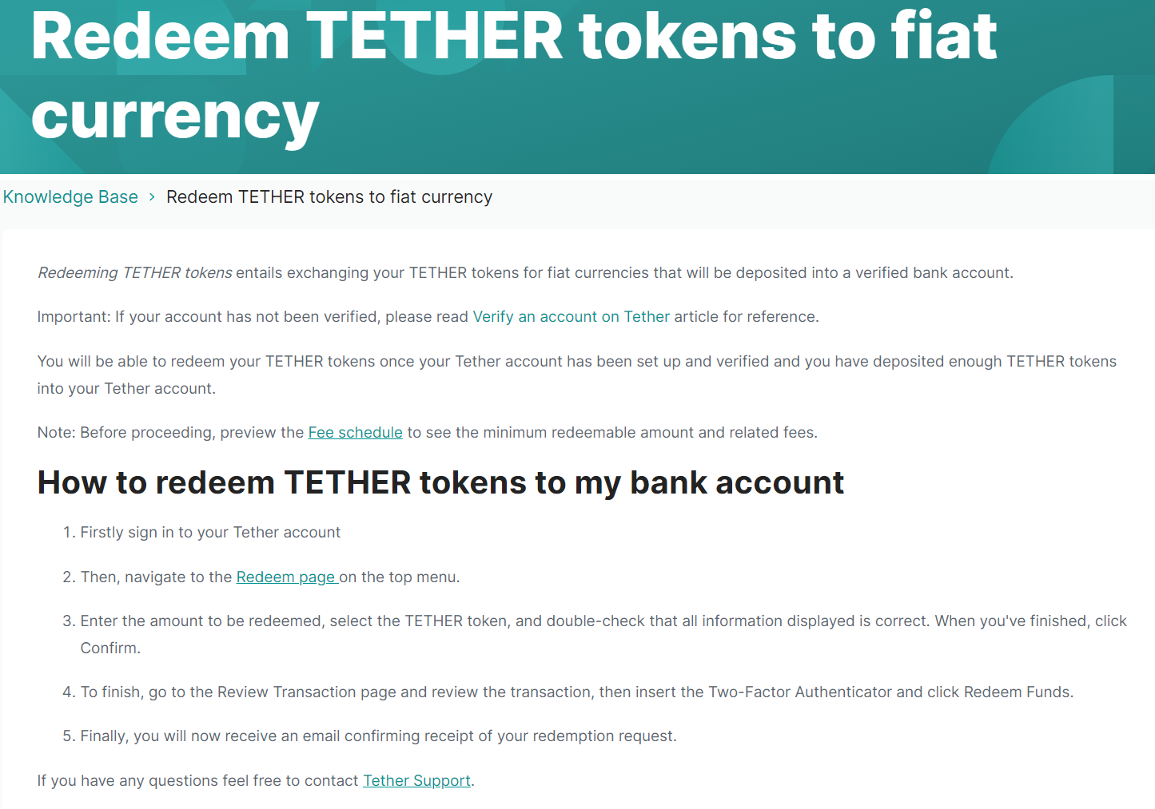
Source: https://tether.to/es/redeem-tethers-to-your-bank-account/

Slide 17
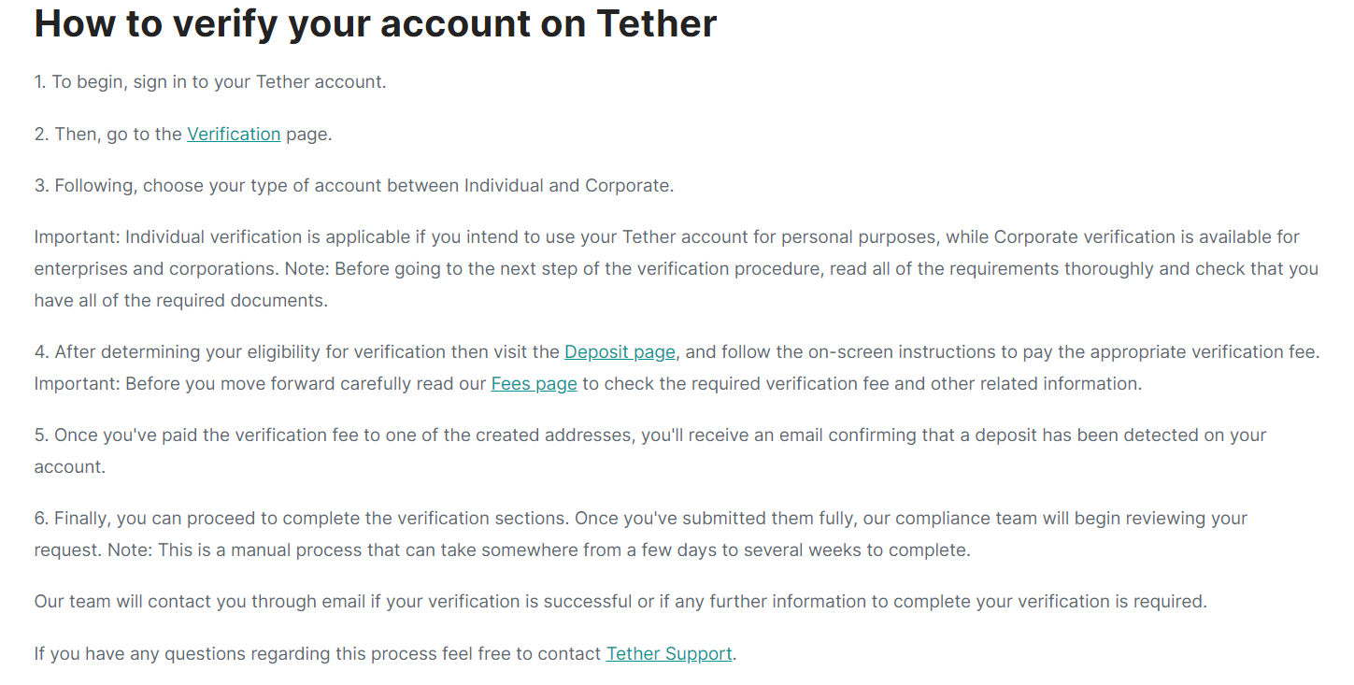

Slide 18
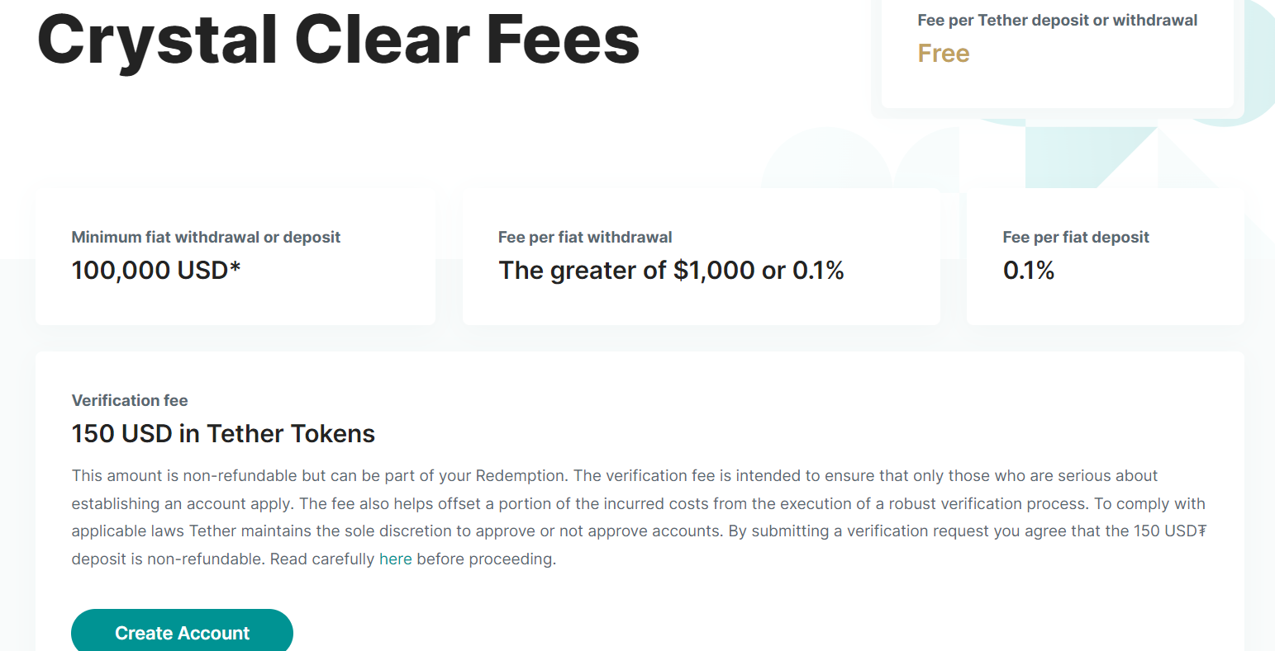

Slide 19
Gen I: Tether (USDT)
Backed by USD one-to-one (originally claimed; later modified)
Created in 2014 (Tether Holdings Limited) in the British Virgin Islands
Key: full collateral by safe assets (at least claimed)
Intermittent minting (signs of breaking promise? Expected ratchet effect?)
Difficult (and costly) to redeem
Potential moral hazard exacerbated by lack of transparency
May used to fuel manipulation (Griffin and Shams 2020; Tether vs. NYAG)
Similar design (USDC, more on this later)

Slide 20
Gen II: MakerDAO (DAI)
Backed by ETH (later multiple assets including USDC)
Created in 2017 as smart contrats on Ethereum
Key: over collateral by risky assets
New DAI created whenever anyone puts in adequate collateral
DAI creators pay “stabilization” fees, effectively a negative interest
Redeem collateral by burning DAI
Lack of capital efficiency (even considering multiplier effects)
Risky arbitrage (Rosam and Ganesh 2022)
Multiple eqm (my own opinion; somewhat reflect in this paper, too)
Similar design (e.g. backed by gold, etc. never got much attraction)

Slide 21
Gen III: TerraUSD (UST)
Backed by artificially created Luna (and some BTC later)
Created in 2019 as a separate blockchain
Key: under collateral by risky assets (including artificial assets)
Anyone can mint new Terra by burning Luna
High interest rates to UST stakers (19.45% on the affiliated protocol Anchor)
Redeem to Luna by burning Terra
Gives issuer seigniorage
Prone to runs
Similar design (e.g. aborted Basis Cash, collapsed Iron, debacled Fei, etc.)

Slide 22
Lessons learned so far
Similarity:
create “safe asset” using other assets as collateral
Differences:
Collateral requirement (safe/risky; full/over/under-collateralization)
Minting/redemption policy (open/proprietary, real-time/intermittent)
Interest rate (positive, zero, or negative)
Problems:
Trust/capacity/runs: Can stablecoin be stable (and useful)?

Slide 23
Some final thoughts
In my opinion:
Stablecoin experiments seem to be coming a full circle
Shifts in collateral decompositions:
Terra’s Makerization (substitute Luna with BTC in Luna Foundation Guard)
Maker’s Dollarization (substitute ETH etc. with USDC in Peg Stability Module)
Signs of failure?
Crypto disrupting fiat or fiat recruiting crypto?
Does not mean stablecoin research are not meaningful – quite the opposite
More economists called for to understand what’s possible & what’s not

Slide 25
AMM
e.g. Uniswap

Slide 26
Costly liquidity provision on AMM: Illustration
Polygon’s MATIC (prevailing price $2) and DAI (stable price around $1)
10 liquidity providers, each deposits 1 MATIC and 2 DAI
Total value locked (TVL): 10 MATIC & 20 DAI $⇒$ imply MATIC price of $2
10 * 20 = 200
Suppose MATIC price drops to $1, arbitrageurs would
exploit the stale price of $2 to sell MATIC on AMM
sell $4.14$ MATIC and get $5.86$ DAI so that $\left(10+4.14\right)\left(20−5.86\right)=200$
pocket in $5.86-$4.14 = $1.72 and push MATIC price closer to $1
Arbitrageur’s gain comes at the cost of liquidity providers
“Impermanent loss” (loss reverted if MATIC rises back to $2)*
*: ignoring small frictions due to trading fees

Slide 27
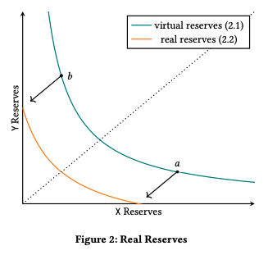
The evolution of Uniswap
Uniswap V1 (November 2018): a proof-of-concept for AMMs
Uniswap V2 (May 2020): basis for the model and data for the empirics
Uniswap V3 (May 2021): allow allocating liquidity within price ranges
https://uniswap.org/blog/uniswap-v3
Multiple fee tiers:
``allowing LPs to be appropriately compensated for taking on varying degrees of risk”

Slide 28
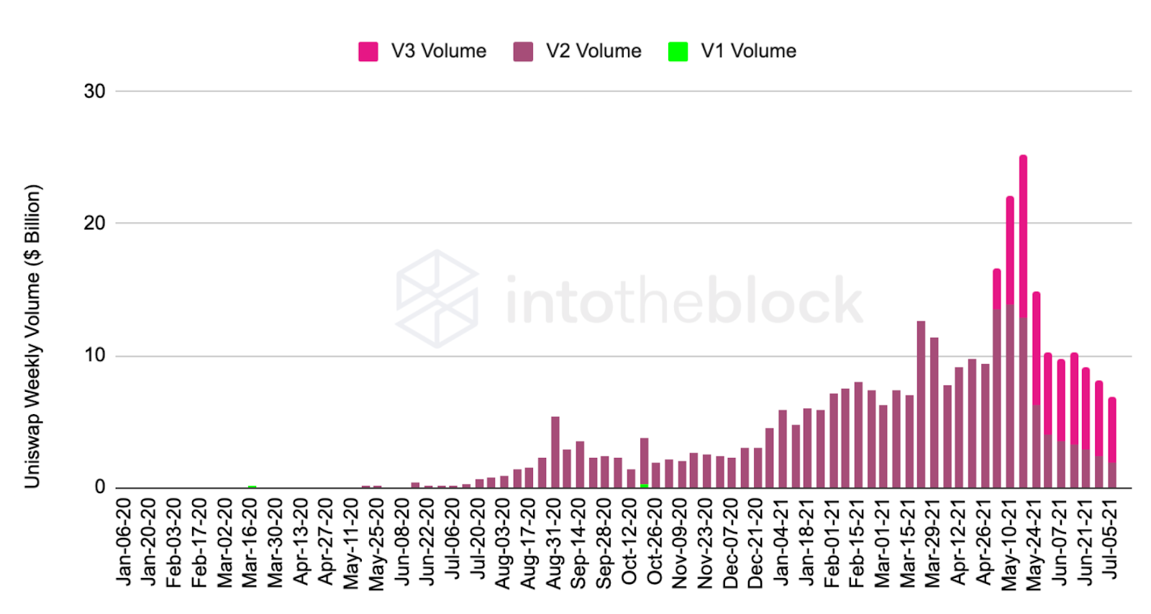
Similar charts can be plotted for TVL

